Slide 1

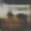
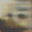
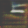
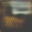
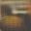
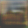
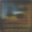

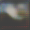

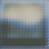
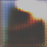
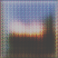

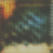
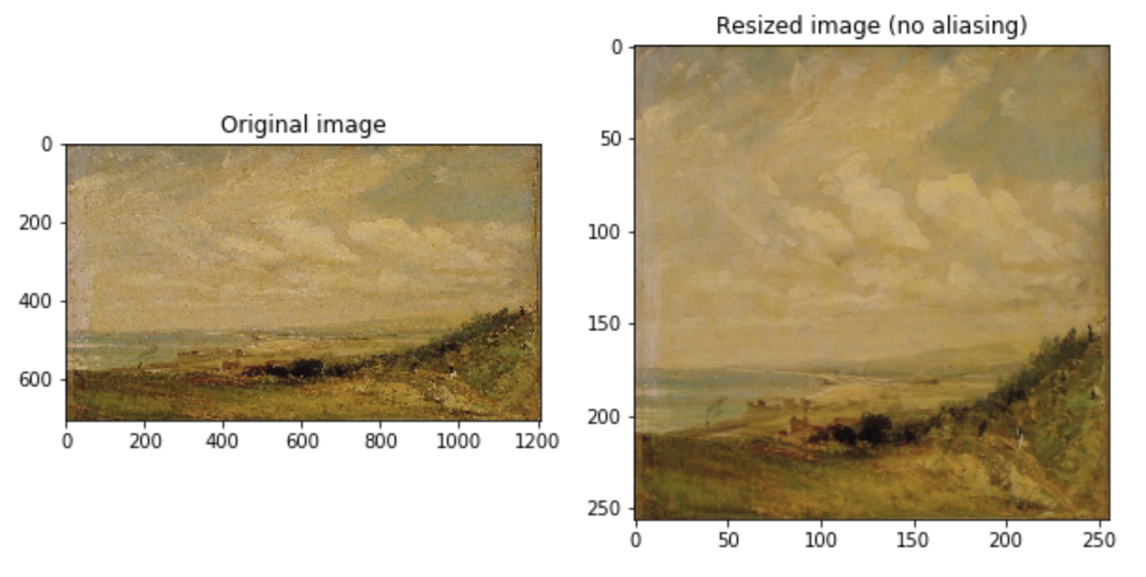
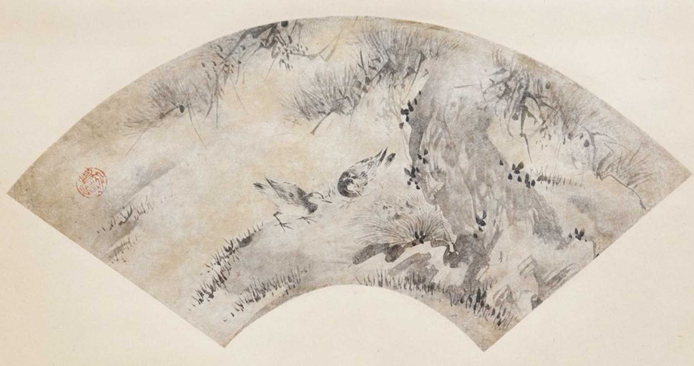

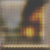
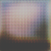
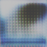
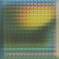
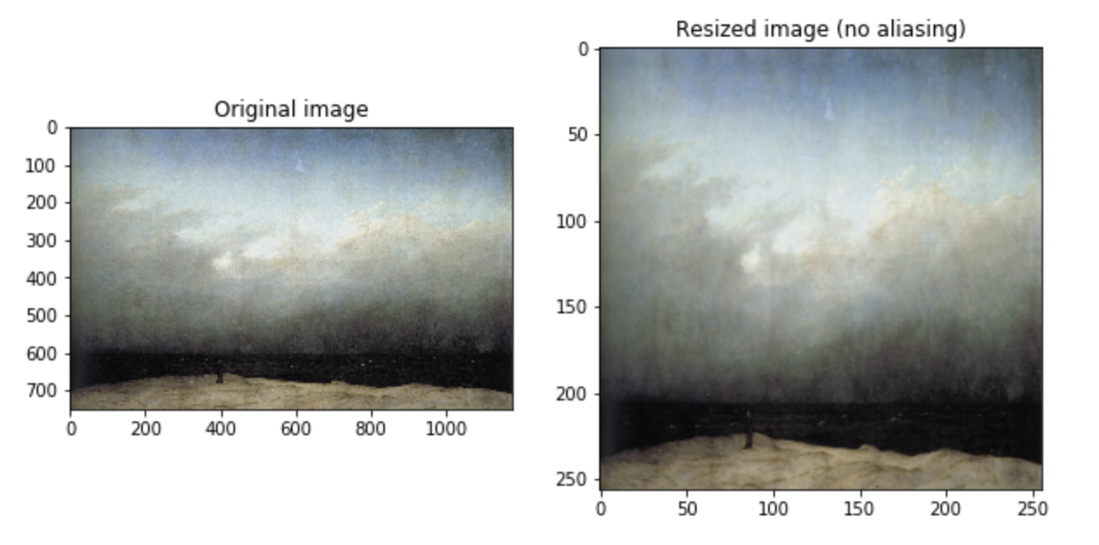
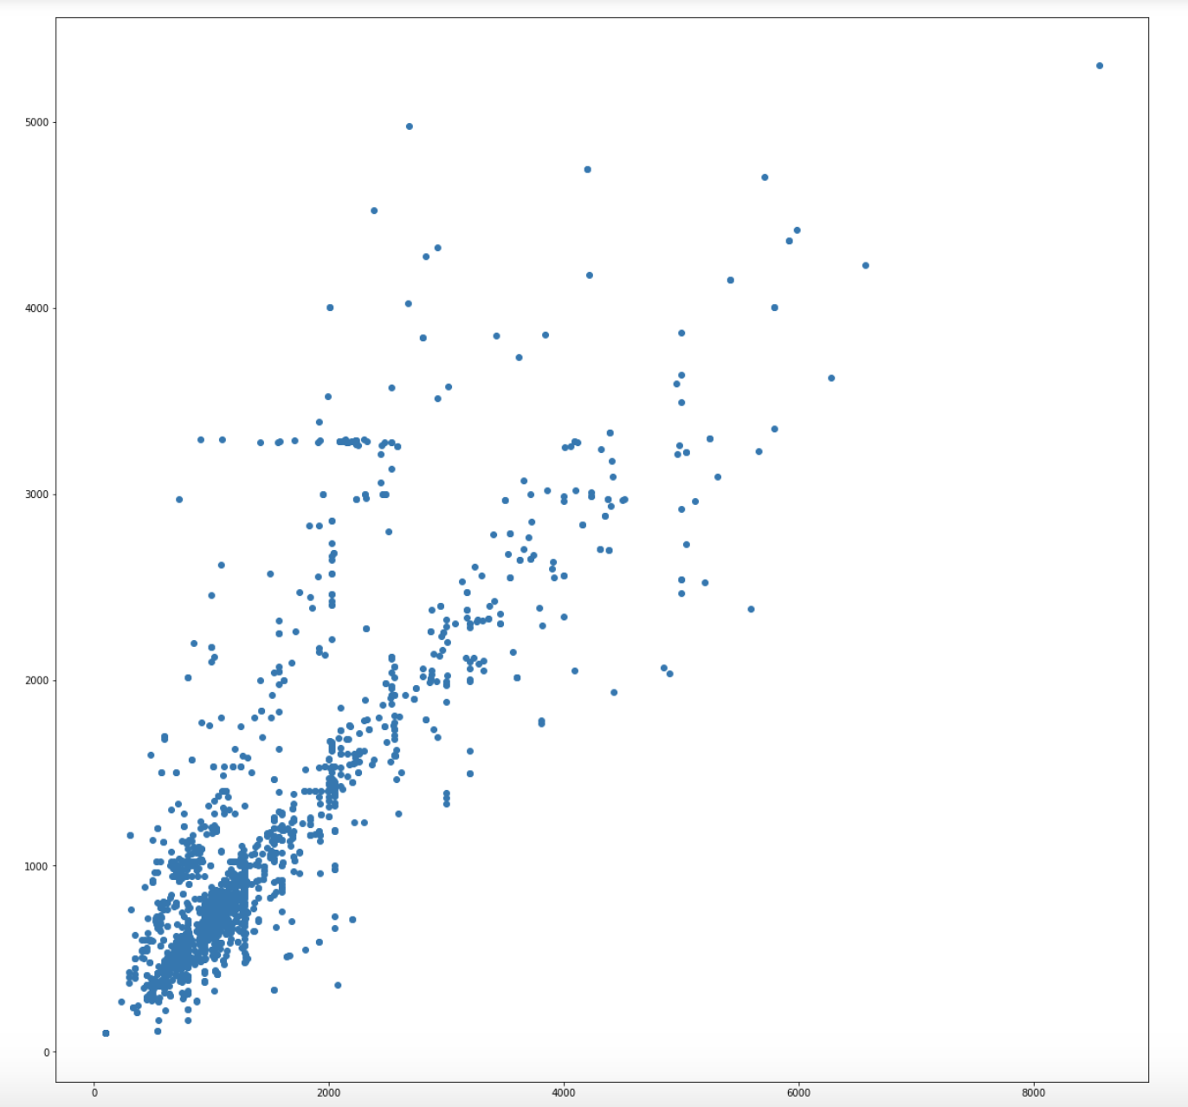
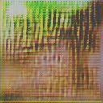
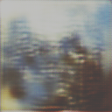
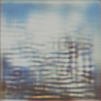
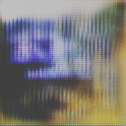
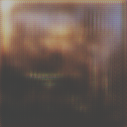
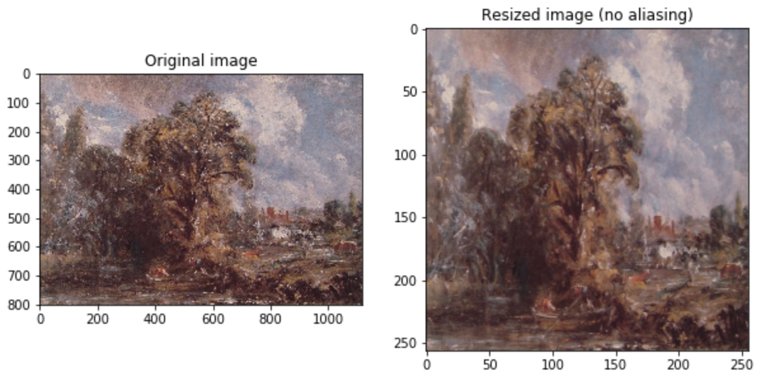
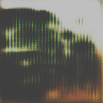
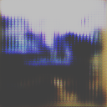
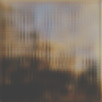
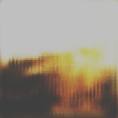
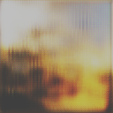
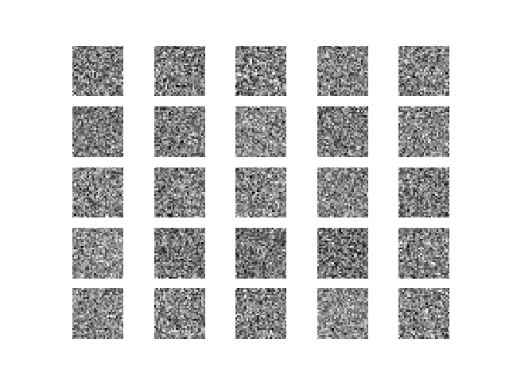
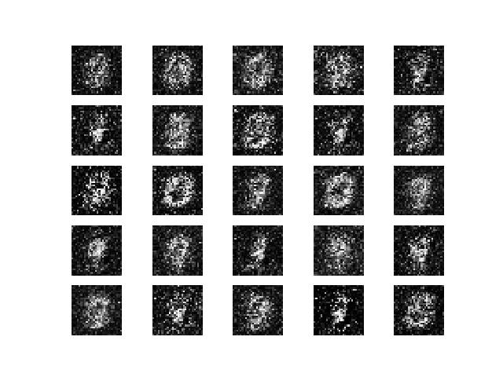
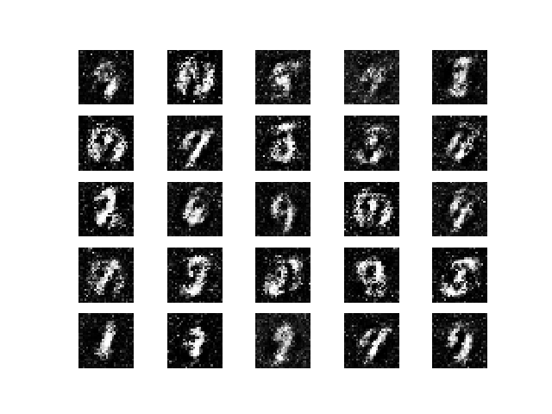
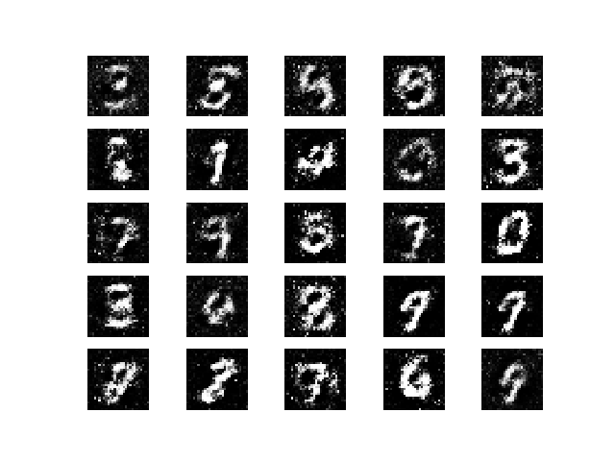
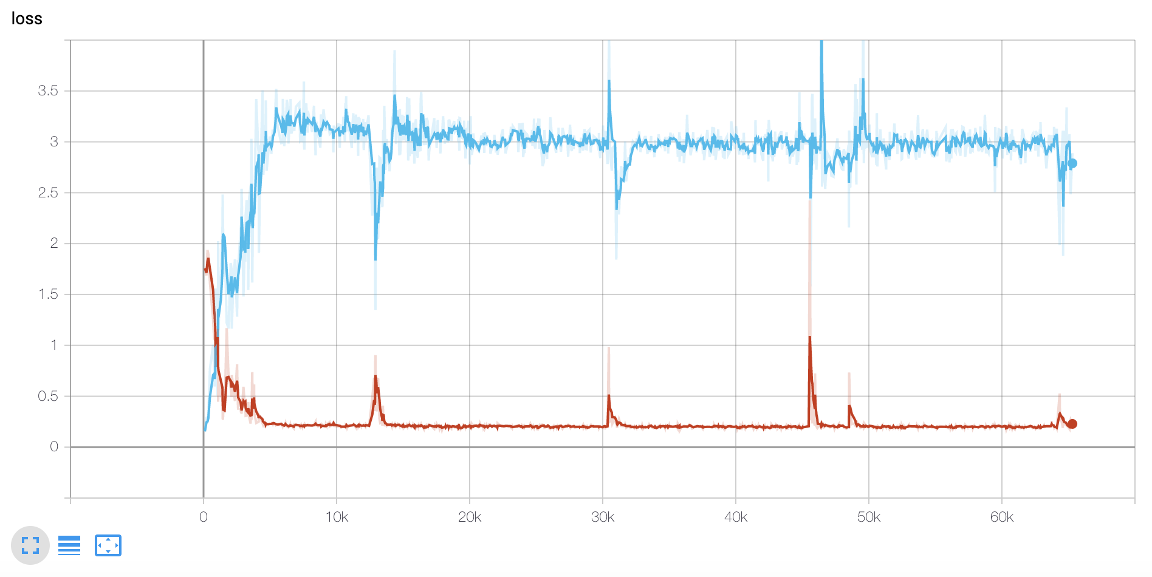
COMP 576 Intro to Deep Learning Final Project - Artificial Art
Jonathan Cai (jmc31), Skylar Xu (yx48)
Rice University, Computer Science Department
Abstract
WikiArt Results
Figure 5. Overall GAN Architecture. We’ve defined the latent space (the random noise) to be R¹⁰⁰ . Also, this diagram depicts the MNIST dataset, but our dataset is much more complicated images of landscapes.
We attempt to replicate studies that have generated art by using Generative Adversarial Networks (GANs), simulating a given distribution of images. The novelty of this project comes in the usage of combined techniques to facilitate learning on the foundation of the traditional DCGAN architecture. We explore the patterns of the generator’s and discriminator’s loss as well as the created paintings formation throughout the training process.
32 x 32
64 x 64
128 x 128
Evident by simply looking at the resulting images and assessing with qualitative metrics, the results from our many runs do not appear to simulate the input distribution with astounding accuracy. There are certainly features that do not seem to correlate with the original dataset - particularly the pixelated appearance of edges and across the entirety of a few images. The human eye can no- tice these features and pretty easily attribute these to be computer-made.
We are not yet sure how to resolve this and achieve the impressive results found in state-of- the-art GAN research, but we hope that the various practical techniques/methods that can produce those results may be discovered and popularized, so that this kind of thing may be feasible in the near future.
Architecture
Data/Preprocessing
As depicted in the figure above, a typical GAN involves two models, the generator and discriminator. During training, the generator produces fake images, and then the discriminator is fed both fake images and real images from the “ground truth” dataset. The results are then backpropagated through both networks. We ended up using two architectures, one more computationally feasible and using only dense layers (described on the left), and one more computationally expensive, using convolutional and transpose convolutional layers (described on the right).
Hyper-Parameters:
Adam Optimizer w/ 0.0001 learning rate
LeakyReLU w/ 0.2 alpha
Batch size 64
Generator:
Input Noise (100x1)
Dense 32768
Reshape 16 × 16 × 128
Convolutional 128 5 × 5
TC 128 4 × 4 (stride=2)
Convolutional 128 5 × 5
Convolutional 128 5 × 5
Convolutional 3 5 × 5
Activation (Tanh + 1) / 2
* BatchNorm and Leaky ReLU after each layer
Total trainable parameters: 202,209,536 Discriminator:
Convolutional 128 3 × 3
Convolutional 128 4 × 4
Convolutional 128 4 × 4
Dropout 0.4
Dense 1
Sigmoid
Total trainable parameters: 100,795,393
Generator : (TC = Transpose Convolutional)
Input Noise (100x1)
TC 4 x 4 x 1024
TC 8 x 8 x 1024
TC 16 x 16 x 512
TC 32 x 32 x 256
TC 64 x 64 x 128
TC 128 x 128 x 64
Image 256 x 256 x 3
Total trainable parameters:
28,458,505
Discriminator :
Convolutional 32 4 × 4
Leaky ReLU
Convolutional 64 4 × 4
Leaky ReLU
Convolutional 128 4 × 4
Leaky ReLU
Convolutional 256 4 × 4
Leaky ReLU
Convolutional 512 4 × 4
Leaky ReLU
Convolutional 512 4 × 4
Leaky ReLU
Dense 1024
Dense 512
Dense 1
Trainable parameters: 1,073,909,633
Dataset:
The images used to train our GAN are from WikiArt (Visual Art Encyclopedia).
Preprocessing:
The performed preprocessing was simple. We scaled every image in our dataset to the desired dimensions (32x32, 64x64, 128x128). We also pruned the dataset, removing images that were far too small to be reasonably comprehensible (there was a cluster of 100 x 100 images) and images that were simply not depicting any sort of landscape.
Figure 2. Example image that was manually
removed from the dataset
Figure 3. Distribution of image dimensions in the dataset
Discussion
Through this research, we have learned first-hand the importance of GPU powered computation, and how it enables feasible training wall time for deep learning models. We tried using many different computers/servers to train our model through a long process of trial and error – including Google Colab, AWS, a separate high-performance GPU laptop, Rice servers (yogi/garuda), and unfortunately, many of these options could not support the resources/memory necessary to run train our variation of a DCGAN model. Practically, to train a GAN to produce art is not trivial.
We discover a variety of practical training techniques that we prove to lead to more stabilized GAN training, manifested in incrementally better and more realistic generated images. We also make some insightful observations that might lead to a deeper understanding of the underlying mechanisms of GANs. Techniques involve tuning the learning rate, utilizing soft labels (.9 instead of 1), pruning the DCGAN proposed in Elgammal et al. [1], modifying the activation function, training the discriminator periodically, and using Spectral Normalization techniques. We extensively test each of these methodologies through various training runs and experimentation, concluding with a proposal for a new architecture with substantive results.
Figure 1. A few visualizations of the dimension
preprocessing performed on three sample images
taken from our WikiArt dataset.
MNIST Results
Initially, we wanted to test the model on a benchmark dataset, MNIST. The results were impressive, considering the simplicity of the model. Below, we can see the convergence to a mapping over the latent space to the distribution of hand-written numbers.
Figure 4. Discriminator and Generator loss from the convolutional model
Contact
References
Jonathan Cai
Email: jmc31@rice.edu
Skylar Xu
Email: yx48@rice.edu
1. Elgammel et. al., “CAN: Creative Adversarial Networks, Generating "Art" by Learning About Styles and Deviating from Style Norms” arXiv:1706.07068 [cs], Jun. 2017.
2. Goodfellow et. al., “Generative Adversarial Nets” arXiv:1406.2661 [cs], Jun. 2014.
3. B, Nikhil. “Image Data Pre-Processing for Neural Networks.” Medium, Becoming Human: Artificial Intelligence Magazine, 18 Jan. 2019, https://becominghuman.ai/image-data-pre-processing-for-neural-networks-498289068258.
4. Audigier, Benoit. “NoArtist: Generating Art with Artificial Intelligence. Can AI Create a Piece of Art?” Medium, Medium, 8 Mar. 2019, https://medium.com/@benoit.audigier/noartist-generating-art-with-artificial-intelligence-can-ai-create-a-piece-of-art-e87695c6d2b5.
5. Brownlee, Jason. “How to Develop a GAN to Generate CIFAR10 Small Color Photographs.” Machine Learning Mastery, 24 July 2019, https://machinelearningmastery.com/how-to-develop-a-generative-adversarial-network-for-a-cifar-10-small-object-photographs-from-scratch/.

